Slide 1
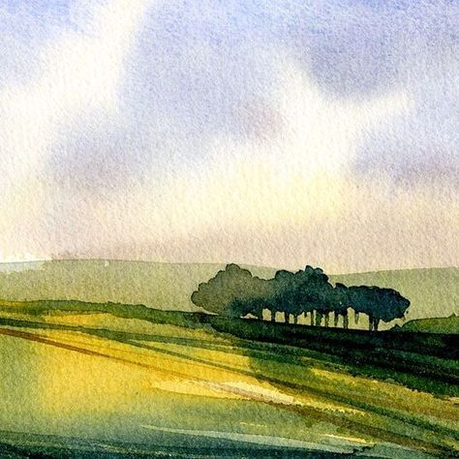
Watercolour:
A Summer Landscape
Rose’s Mini Course

Slide 2
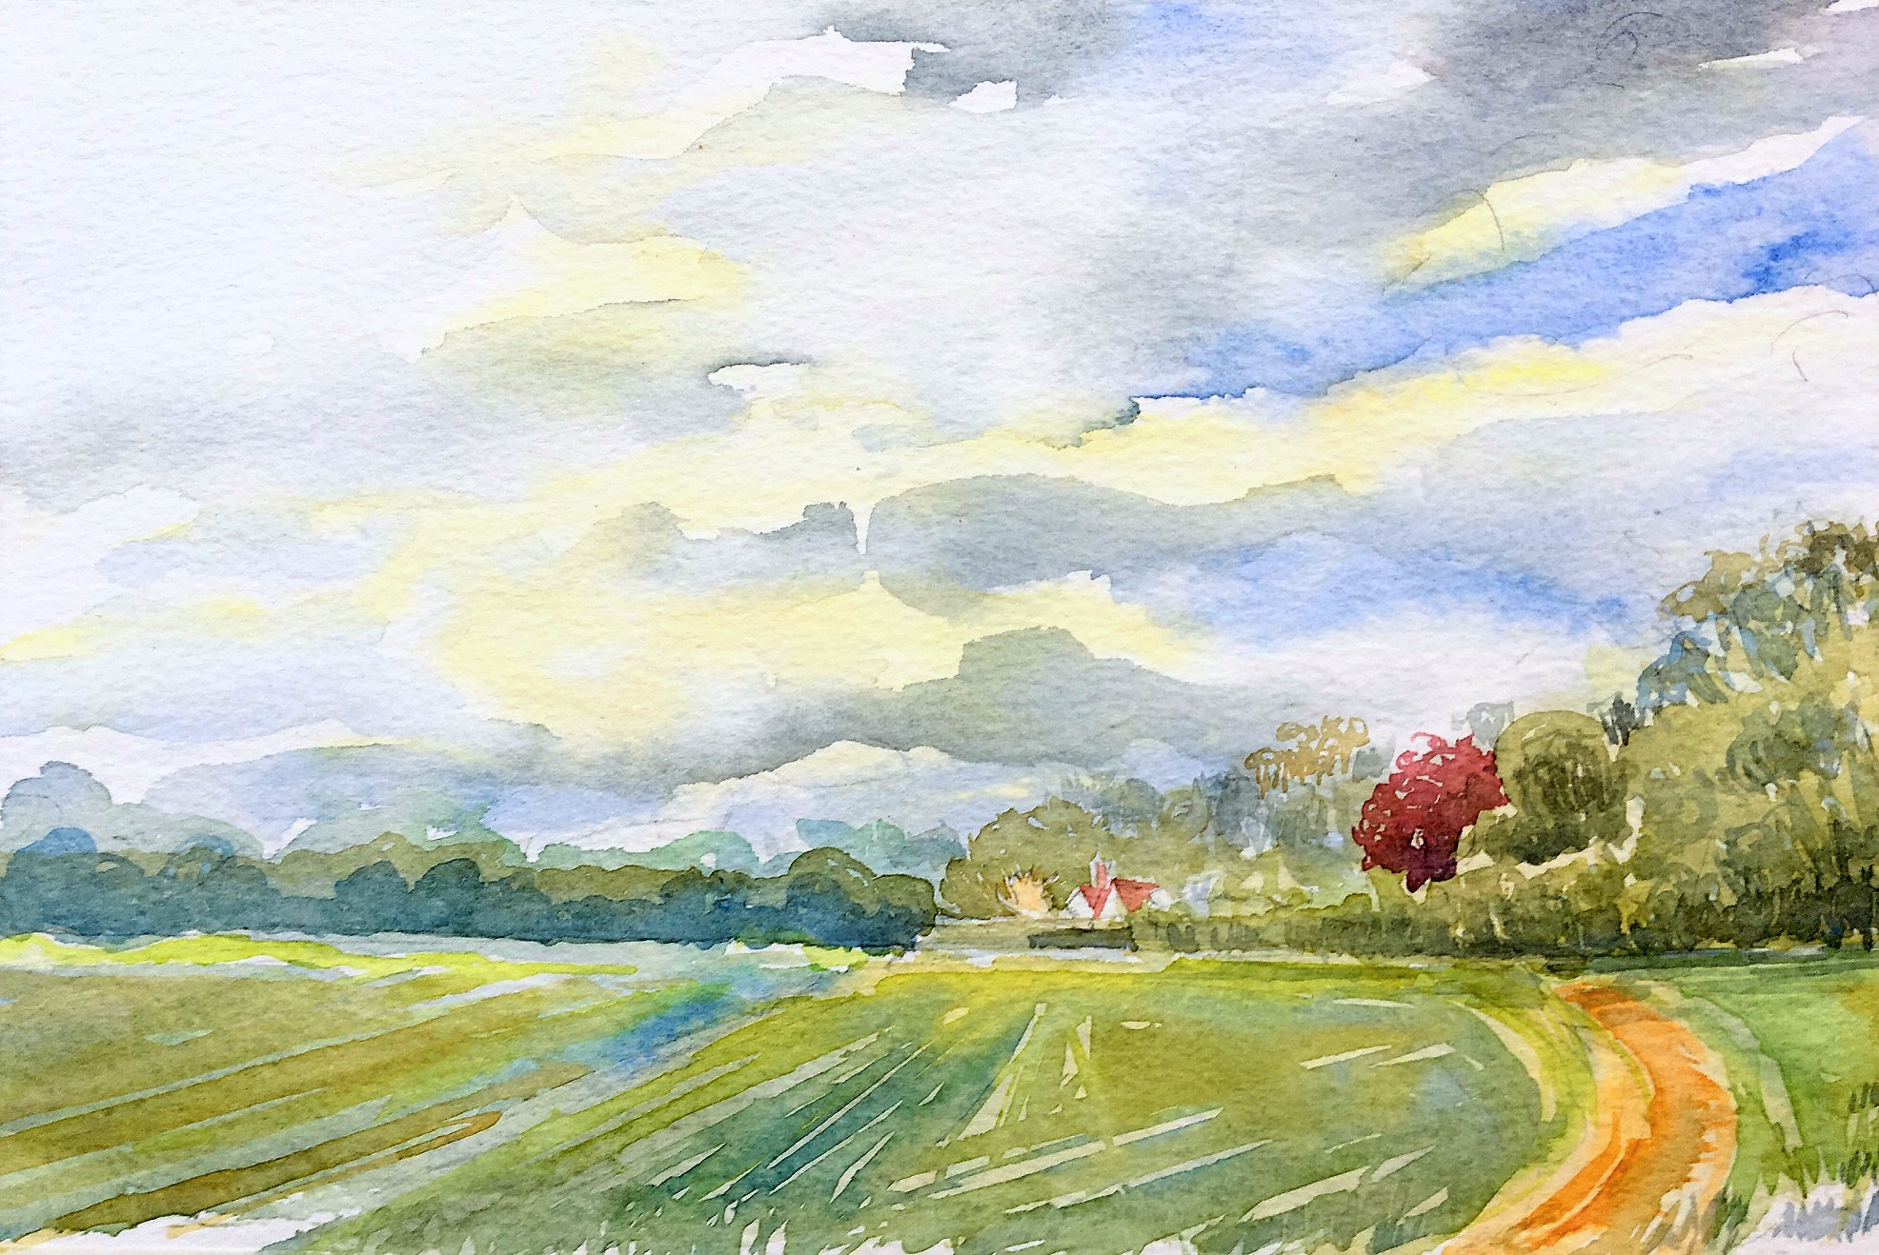
Workshop Objectives
Complete a simple layered landscape using glazing techniques to show aerial perspective
Explore watercolour techniques: Glazing; wet on wet; graduated washes, lifting out; wet on dry
Produce a reference sketch showing dark and light tones
Produce a simple sky with lifted clouds
Produce a watercolour sketch from your drawing
Design a summer landscape from a reference photograph
‘Path’, Hartley Wintney. Rose Bramwell

Slide 3
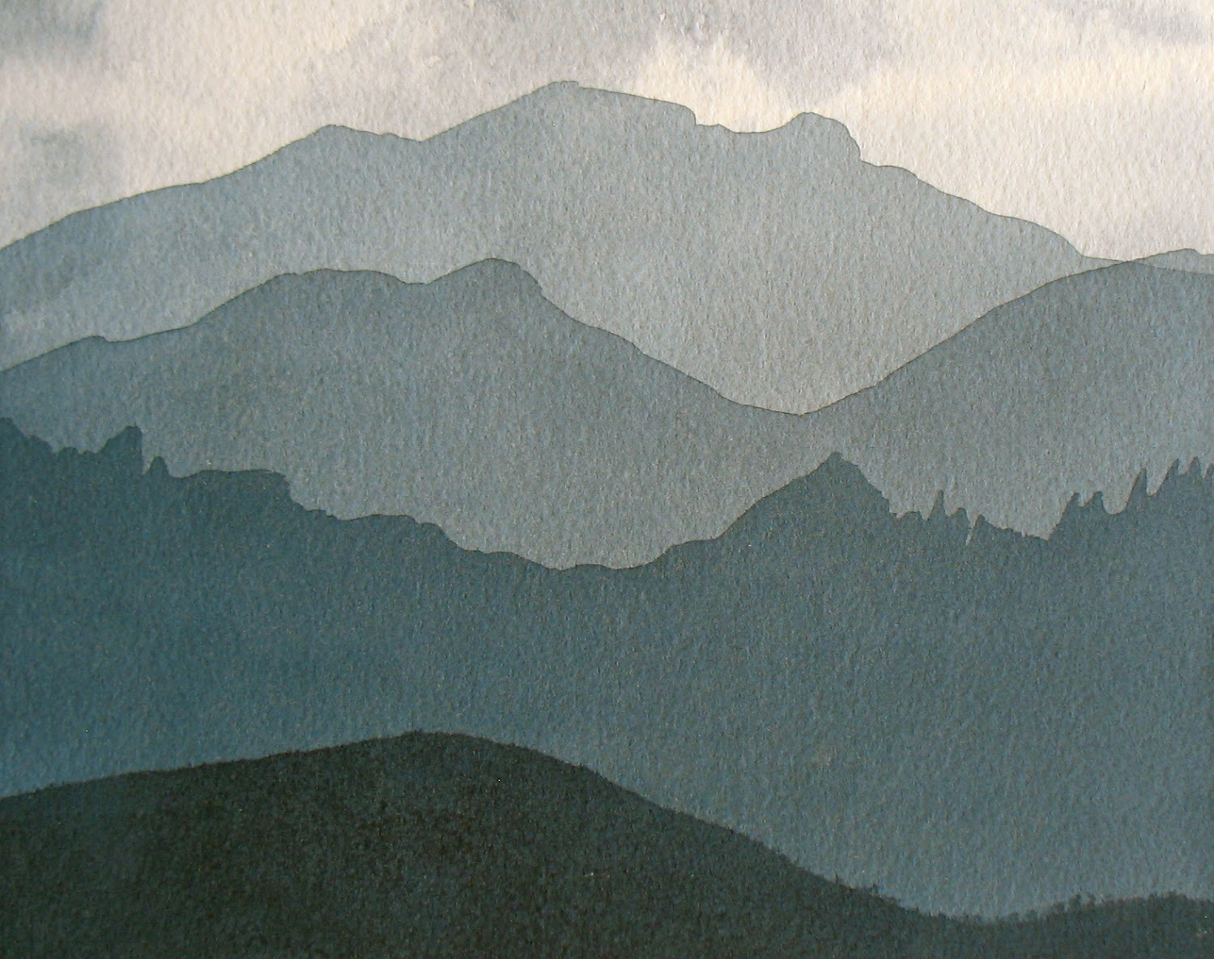
Simple Glazing to create Aerial Perspective
Task One
Using Painting Values with Layered Washes and using mixed grey.
To mix a grey: French Ultramarine Blue, Alizarin Crimson, and Indian Yellow or Yellow Ochre.
Layering grey washes to build up values from light to dark. This will create a sense of aerial or atmospheric perspective through these value changes.

Slide 4
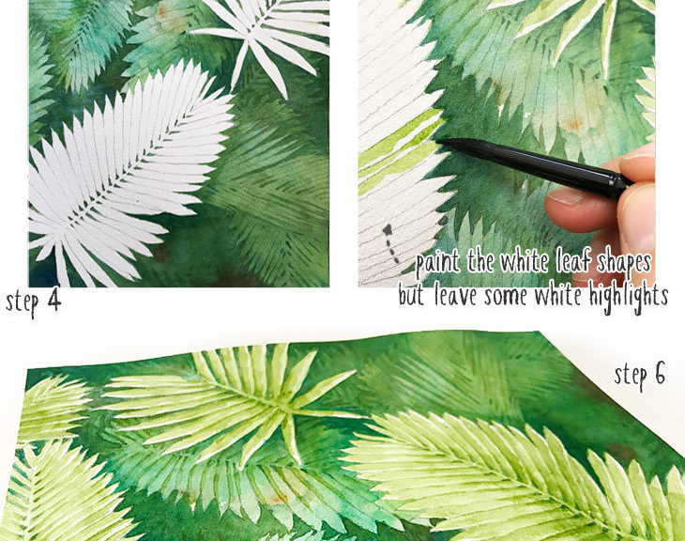
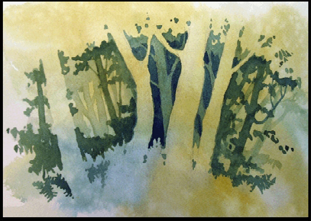
Negative Painting

Slide 5
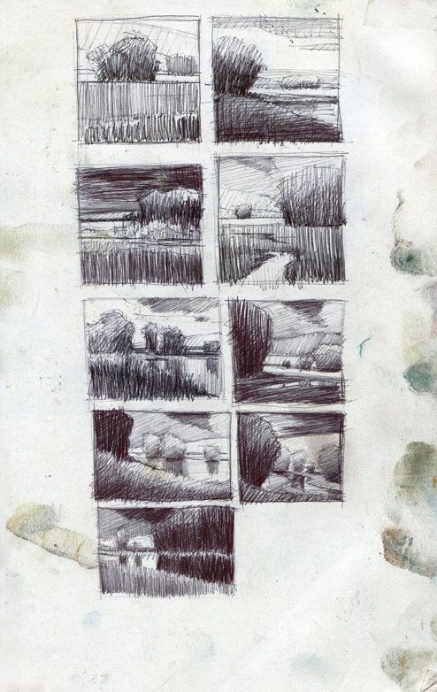
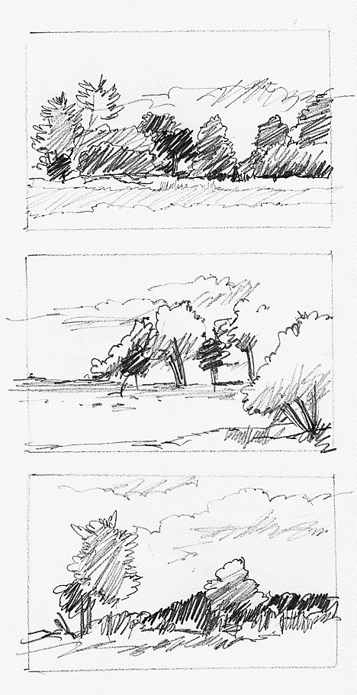
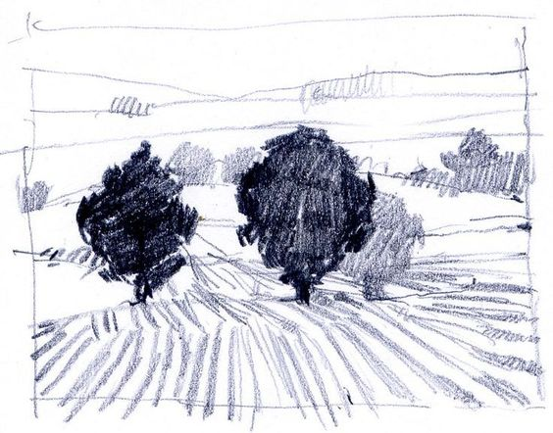
Drawing For Purpose
Many students overlook the need for any drawing before a painting.
Drawing beforehand, sorting out composition, angles and proportions, tones and perspective, angles and ‘leading eye’ or ‘emphasis’ saves much time in the long run.

Slide 6
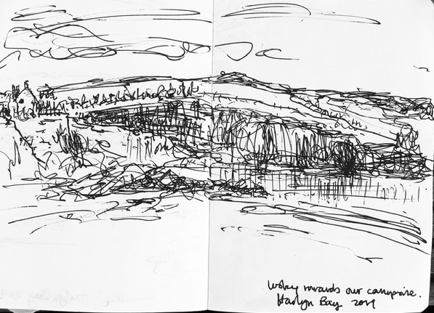
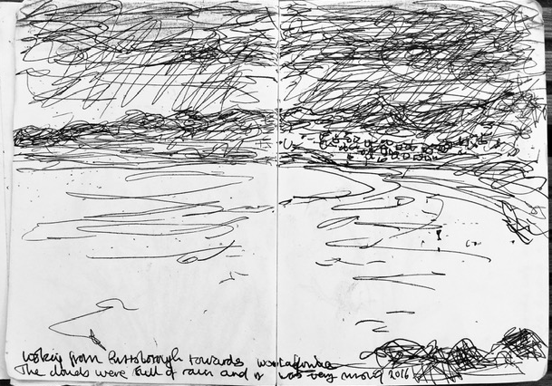
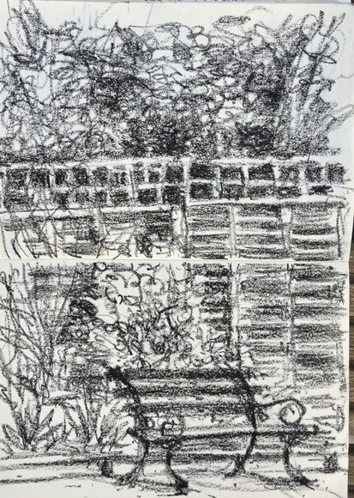
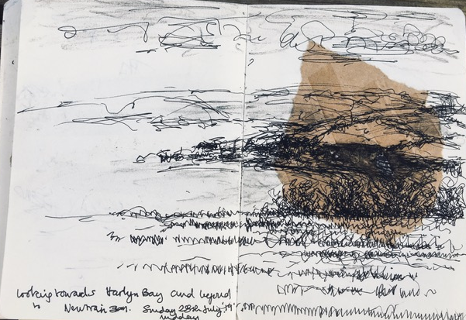
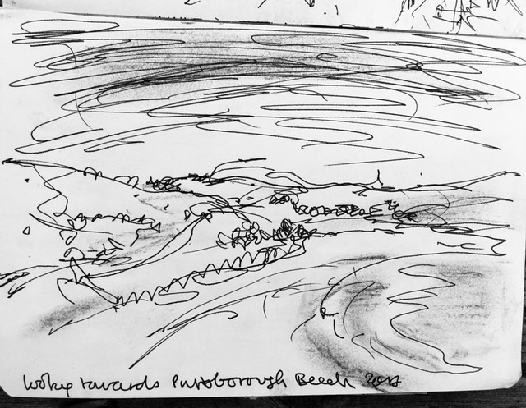
Rose’s sketches from first hand observation.
All done very quickly, mostly in 10-15 minutes.
YOUR TASK:
Select a composition from your reference photo and complete a tonal sketch.

Slide 7
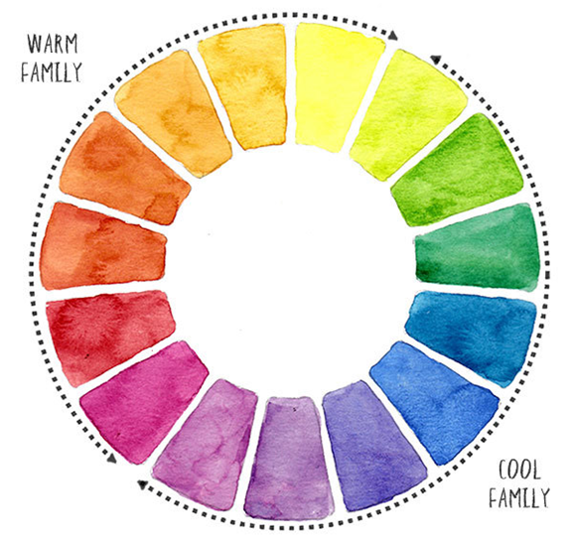
Summer
Yellow Ochre
French Vermillion (A Warmer red)
Cadmium Yellow/ Cadmium Red
French Ultramarine
Cobalt Blue
Raw Umber
Sap Green
A Note on Warm Blues: Warm blues are those with a purple bias rather than a green bias. They will appear to come forward in a painting, whereas cool blues will recede. It is useful to have a warm and a cool blue in a split primary palette - when mixed together they will create a mid-blue. Examples of warm blues are Ultramarine, Indanthrone Blue and Cobalt Blue

Slide 8
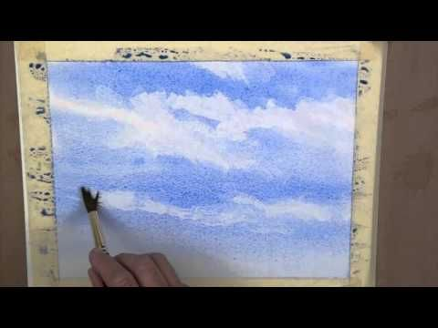
A Basic Summer Sky
YOUR TASK:
Using just ultramarine blue and ‘lifting’ out the clouds we can create a simple sky.
Add a simple strip of landscape below to give the sky context.

Slide 9
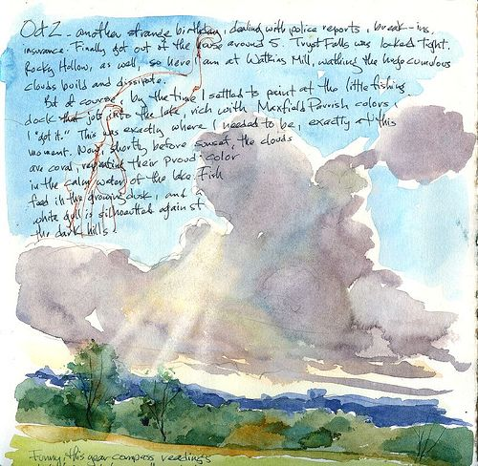
Watercolour Sketching
(Artist: Unknown)
Use of direct washes, use of the whole paper bleeding to the edge.
Using the sky as a backdrop for notes which relay thoughts and response to the first hand observation of the location.
Compositionally the sky takes up at least 3/4 of the painting. The actual landscape is kept very simple.

Slide 10
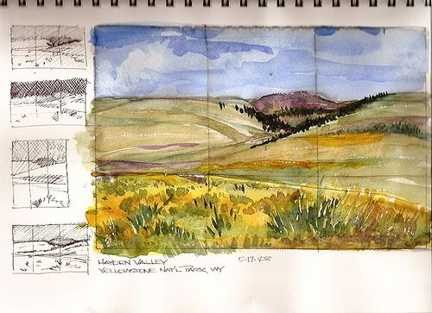
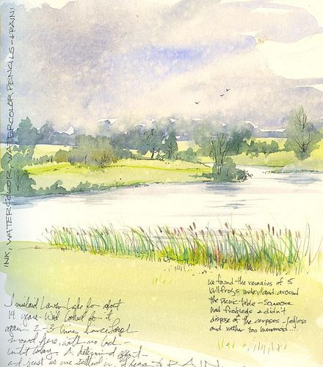
Cathy (Kate) Johnson: Watercolour Sketching
Use of gestural mark making, notes, diagrams and tonal thumbnails.
Your Task:
Moving on from the initial pencil thumbnail sketch, have a go at a watercolour sketch. Practice techniques to be used in your larger painting, sort out the colour palette and experiment with textures.
Sometimes, the watercolour sketch can be a delightful
painting in itself!

Slide 11
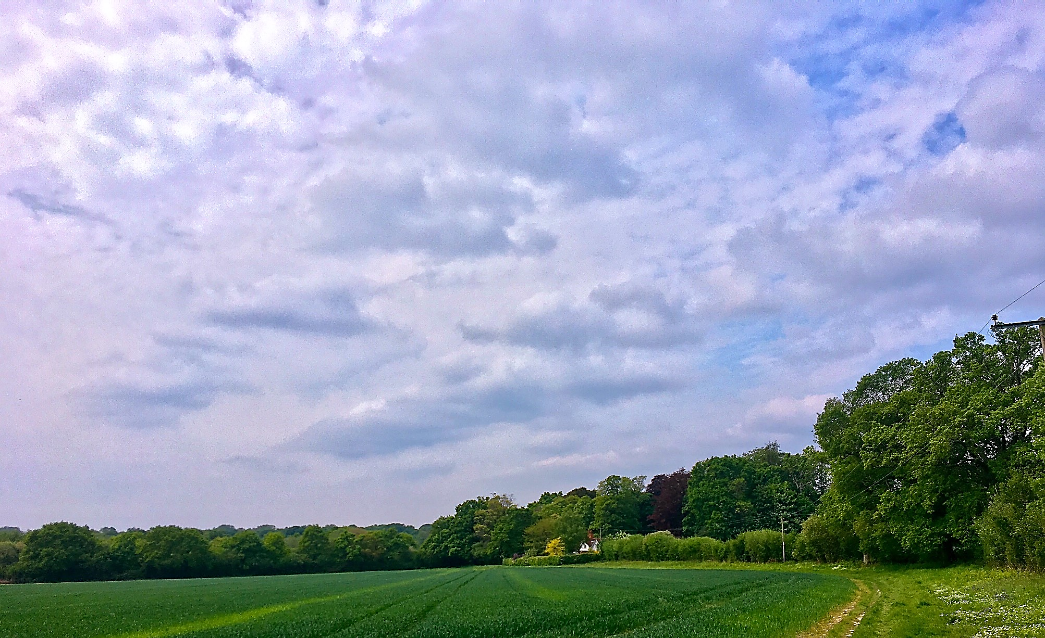
Using
Photographic References
It’s perfectly ok to use a photographic reference as an aid to our watercolour painting. However, we need to be careful not to ‘copy’ the photo or try to replicate the nature of photographic colours or their tonal value.
Photographs ‘flatten’ the middle and far distance making it look much smaller and insignificant. When we look at the same view our eyes unconsciously enlarge the middle distance and we see it in isolation; it fills our vision.
Also, don’t fall into the trap in trying to include every detail in the photograph; simplify the composition, be selective.
In this painting I used another sky reference for my painting since I felt the sky in the photo lacked the atmosphere and colour I wanted.
Photograph and watercolour
Rose Bramwell

Slide 12
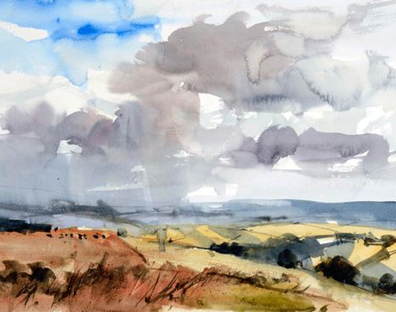
John Hoar
Use of a warm palette to suggest late summer, early Autumn with an impending rain storm maybe?
Composition focuses on the drama of the sky which takes up 2/3 of the painting.

Slide 13
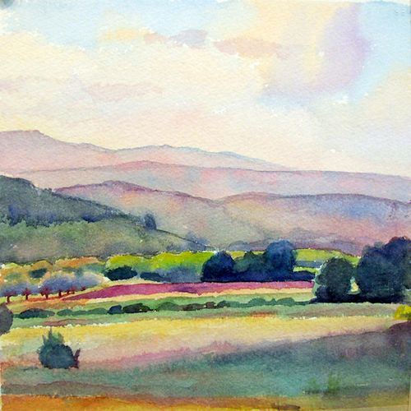
Susan Abbot:
“I find plein air painting exhilarating. Exploring until I find the right painting spot, figuring out a composition, slowing down enough to closely study nature's colours and shapes, feeling the cool breeze and warm sun--there's so much pleasure in the experience of painting outdoors”.
A warm palette with an emphasis on misty pinks and purples suggesting early evening in summer maybe?
An emphasis on pattern with the zig zag of fields which leads the eye to the horizon.

Slide 14
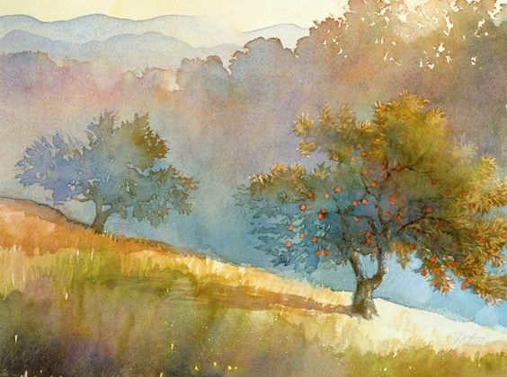
Robert Steele: Illustrator
Analogous colours used from the warm palette which suggests height of a hot summer day. With a misty background this could be late afternoon, early evening.

Slide 15
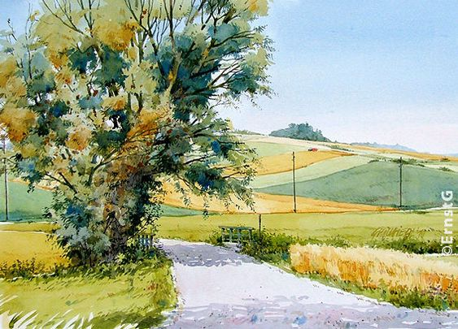
German Artist:
Unknown
Summer fields
When this motif was created we had a real hot summer. No rain wash for weeks like at the moment. You could get melancholy if you are not already. I can still remember that Saturday late morning, when it was still sweaty in the shade around 30 degrees. Not ideal for watercolour either, but much better than wet. You can see the colour separation very well, between the already ripe barley and the wheat lagging behind.
Crisp, bright palette using warm colours and complementary colours. This evokes a feeling of the middle of the day in the summer as well as an intensity of heat.

Slide 16
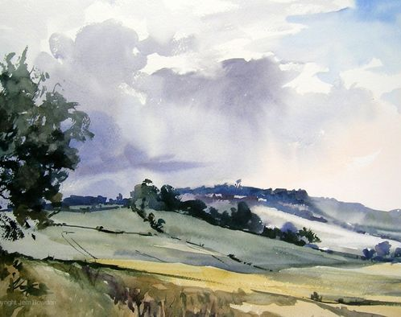
Jem Bowden:
Plein Air Artist
Original watercolours by Jem Bowden. This set of original watercolours are painted on location ‘en plein air’.
A slightly cooler palette with a note of warm colours in the foreground. The tree is in full leaf and there is a glint of warm blue sky in the corner. This suggests a summer day after a brief rain storm, the sun is peeping through and where the temperature has cooled a little.

Slide 17
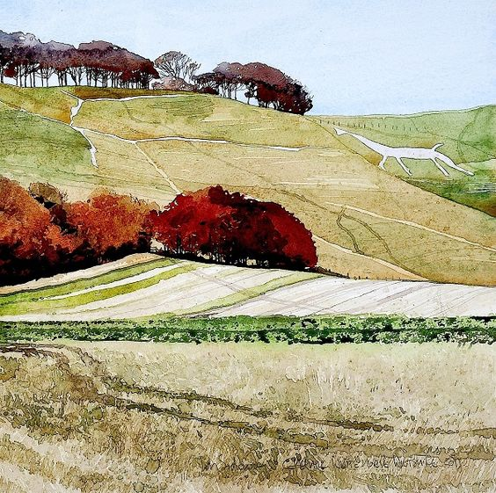
Ian Sidaway
Ian uses interesting compositional effects, dividing the picture space with the edges of the fields and hedgerows. This leads the eye through the painting to the line of cool purple trees on the horizon and then to the horse shape. Elelemnts of the purple are in the foreground trees but are slightly warmer with added reds. The sky is slightly cooler in blue. We can guess it’s maybe early Autumn.

Slide 18
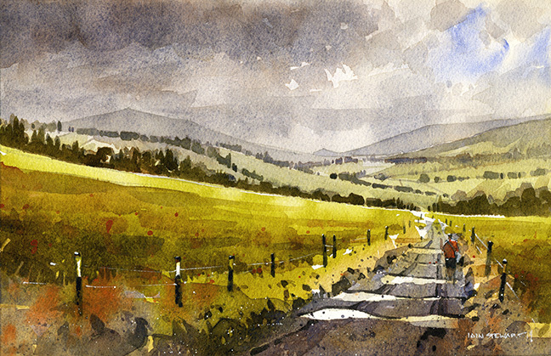
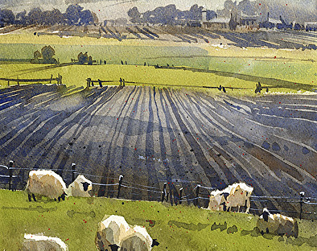
Iain Stewart
Iain Stewart is a watercolour artist and illustrator and a signature member of the National Watercolour Society. His work has received numerous awards in international competitions and he is a much sought after artist.

Slide 19
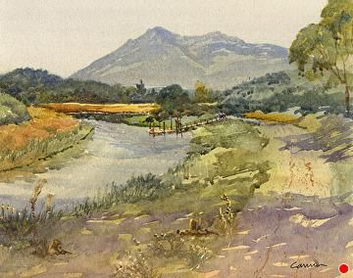
Larry Cannon

Slide 20
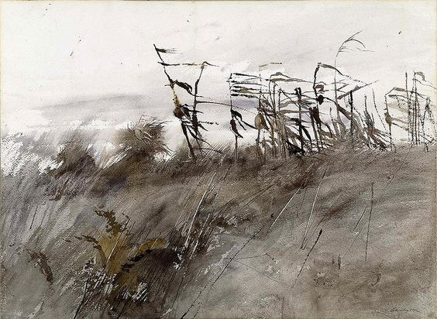
Andrew Wyeth
Watercolours
(1950-2009)
Andrew Wyeth watercolour on paper mounted on paperboard sheet
Depicting tattered cornstalks in a harvested field, November First captures the cold damp of late autumn, portraying the inevitable cycles of decay and renewal. Wyeth steadfastly maintained his dedication to painting the people and places that are familiar to him in Chadds Ford, Pennsylvania, and Cushing, Maine. The cornfield shown in this watercolour is located near his studio in Chadds Ford, behind the house of Dr. Margaret Handy, the paediatrician who cared for Wyeth’s two children.

Slide 21
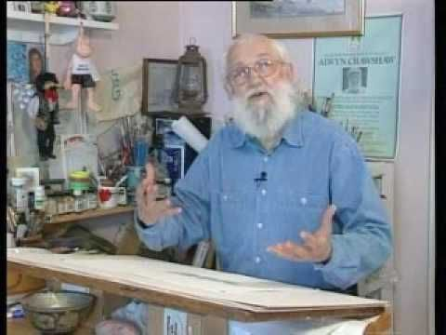
Alwyn Crawshaw
A very popular Artist and teacher who runs many workshops, painting holidays, YouTube Tutorials and has published many books on Watercolour Painting.
Married to June Crawshaw, also a Watercolour Artist who has also published Watercolour Painting books.

